Slide 1
Parents’ Meeting
Introduction to Read Write Inc.
Notes:
Approximately 20 minutes is needed for this session.
Notes are provided to help you lead the presentation.
Notes in italics are for your attention only.
This bitesize parent session is designed as an introduction to Read Write Inc when you first implement the programme in your school and for parents of new YR children each September.
Use the other bitesize parent PPTs throughout the year to discuss and practise how they can help their child at home based on the child’s group.
Notes are provided to help you lead the presentation.
Notes in italics are for your attention only.
Provide copies of ‘Reading at Home Booklet 1 or 2’ from Oxford Owl.
Booklet 1 is sound groups and Ditty/ Red Groups and Booklet 2 for Green – Grey Storybooks.

Slide 2
Read Write Inc. Phonics
Children learning to read in YR– Y2
Taught in groups based on their stage of reading
Notes:
Who Is Read Write Inc Phonics for?
(Click) Phonics is for children in Reception, Y1 and Y2 who are learning to read.
Phonics is also for children in Y3 and Y4 who haven’t met the KS1 reading expectations. They need to catch up.
(Click) Fresh Start is for children in Y5 and Y6 who are still learning to read.
Fresh Start is structured in the same way as the Phonics programme, but uses age-appropriate texts.
Each half-term, we assess and group our children based on their stage of reading not age of reading. This means all children practise reading at the right level.
Explain how you group across YR/ across KS1, across Y3/4 as applicable to your school.

Slide 3
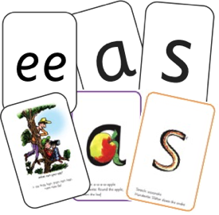
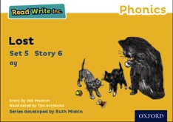


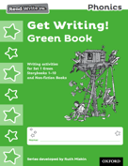






Read Write Inc. Phonics daily lessons
Notes:
What Read Write Inc. does is simple - we teach sounds (click), children practise reading and spelling words containing these sounds (click), then we give children decodable books (click) containing sounds and words they can read.
They read each Storybook three times at school and again with you at home.
On each reading, children’s fluency increases and the more they can focus on what the story is about.
Children also learn to spell the words they have been reading and develop their ideas into sentences so that they can write about the Storybooks they read.
Alongside this we read stories to children: (click) stories they cannot yet read for themselves
Our aim is for children to finish the RWI Phonics programme quickly so they can start reading these books for themselves.

Slide 4
What is phonics?
Sounds- the sound that letters make e.g. m
Graphemes- are another name for the letters we use to write the sound.
Notes:
All words are made up of individual sounds. These sounds are merged together to form words.
e.g. in ‘mat’ we have the sounds ‘m’, ‘a’, ‘t’, ship – ‘sh’, ‘i’, ‘p’.
Click A grapheme is another name for the letters we use to write the sound. The spelling of that sound on the page.
Phonics is the method of teaching reading through the identification of sounds and graphemes.
The new National Curriculum ensures that all children are taught Phonics systematically.
This gives your children the tools to read any word.

Slide 5
English alphabetic code
44 sounds
26 letters
Over 150+ graphemes (letter combinations)
One of the most complex alphabetic codes in the world.
Notes:
We use 44 sounds to make all the words in the English language.
This means we’ve got a problem.
We’ve got 44 sounds and only 26 letters.
The 26 letters work singly, in pairs and sometimes in threes to represent one sound.
We have to group letters together to write some sounds e.g. ‘igh’, ‘air’.
In English we have more than 150 ways to represent 44 sounds, using the 26 letters in the alphabet.
Click
This makes our language one of the most complex in the world!

Slide 6
Speed Sounds Set 1 and Set 2
Notes:
Using RWI, we make learning to read easy for children because we start by teaching them just one way of reading and writing every sound. Here they are on the Simple Speed Sounds chart we use in class.
We teach Set 1 sounds first - (sounds as far as a e i o u).
Children need to know sounds – not letter names – to read words.

Slide 7
Speed Sounds Set 3
Notes:
Once children know one way of reading and writing every sound, they start to learn spellings for each sound they already know.
Point to the chart to show.
For example, they know ‘ay’ and now learn a-e and ai as other spellings for the same sound.

Slide 8
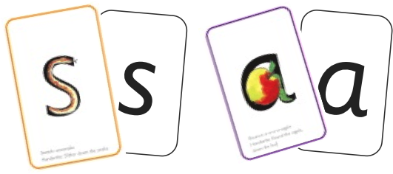
Sounds + blending = reading
+
Notes:
Alongside teaching children sounds, we teach them to blend sounds to read words e.g. s-a-t, sat.
We use Fred Talk to help children read.

Slide 9
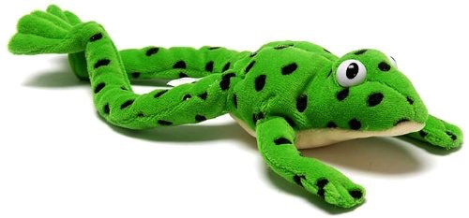
Fred
Notes:
Let me introduce you to Fred.
Fred can only speak in sounds. He says d-o-g, h-a-t etc.
Speaking like Fred helps children to understand that words are made up of sounds.
Fred helps children practise blending sounds together because he needs the children to say the words for him. Fred says d-o-g, children tell him the word is dog.
This is how we quickly teach all of our children to blend.

Slide 10

Teach spelling using Fred Fingers
Notes:
We use Fred Fingers to help children sound out words to spell easily.
It means they do not have to memorise lists of spelling words.
It is a tool so they will be able to spell any word.

Slide 11
What can I do?
Use pure sounds, not letter names
Use Fred Talk to read and spell words
Listen to your child read their Storybook every day
Read stories to your child every day
Notes:
We will run regular bitesize meetings to look at each of these in more detail.
Provide copies of ‘Reading at Home Booklet 1 or 2’ from Oxford Owl.
Booklet 1 is sound groups and Ditty/ Red Groups and Booklet 2 for Green – Grey Storybooks.

Slide 12
Comprehension
Once children reach year 1 they will begin comprehension lessons
Complete comprehension
Focusses on key skills
Children who can read fluently will have more comprehension skills.

Slide 13
Any other questions
Q&A

