Slide 1



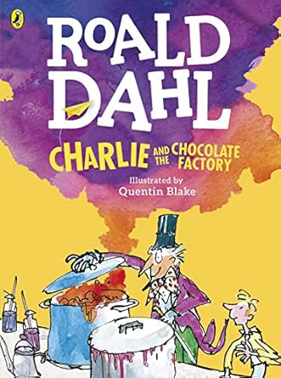


Y3 Knowledge Organiser – Autumn 1
Geography - Where does chocolate come from?
In this geography unit, we will discover where chocolate comes from and follow its journey from cocoa bean to chocolate bar. We will compare Warrington with Ghana, learning about their weather, landscapes, jobs and how people live.
We will explore why Ghana is a great place to grow cocoa and how chocolate connects people around the world.
What we are reading this half term:
English
Lots of our reading will link to our exciting geography topic. We will use a range of fiction and non-fiction texts to inspire our writing. During this unit, we will write a third-person narrative retell, an explanation text and a letter.
Geography Vocabulary | Definition
Climate | The usual weather over a long period of time.
Tropical | Hot and wet weather for most of the year.
Cocoa | The beans used to make cocoa.
Harvest | Collecting crops when they are ready.
Export | To send goods to another country.
Import | To bring goods into a country from somewhere else.
Trade | Buying and selling goods between people or countries.
Equator | An imaginary line around the middle of the Earth where it is usually hot.
Mathematics
This half term, we will be learning to:
Read, write, compare and order numbers to 1,000.
Recognise the place value of each digit in a 3-digit number.
Add and subtract numbers using mental and written methods.
Solve one- and two-step problems involving addition and subtraction.
Recall and use the 2, 3, 4, 5, 8 and 10 times tables.
Use multiplication and division to solve problems using equal groups, arrays and sharing.
Science - Magnets
In Science, we will explore magnets and discover how they work. We will investigate which materials are magnetic, learn about magnetic forces, and find out how magnets can attract and repel.
Science Vocabulary | Definition
Magnet | An object that can attract some metals.
Magnetic | A material that is attracted to a magnet.
Force | A push or pull. Magnets can pull objects without touching them.
Attract | When two magnets or a magnet and magnetic material pull towards each other.
Repel | When two magnets push away from each other.

