Slide 1

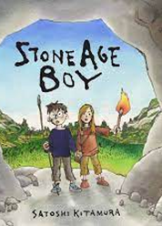
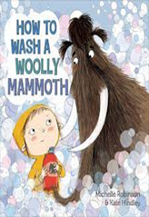
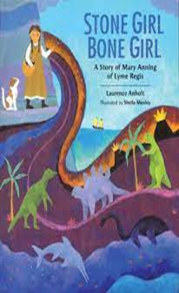

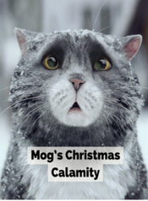
Y3 Knowledge Organiser – Autumn 2
History - The Stone Age
We will travel back to prehistoric Britain to explore life in The Stone Age. We will learn how people used stone tools, hunted animals and gathered food.
We will place events on a timeline and explore changes from the early to the late Stone Age.
We will find out how farming changed daily life, explore homes such as Skara Brae and use evidence to compare life then with life today.
Finally, we will explore what happened after The Stone Age, during the Bronze and Iron Ages.
What we are reading this half term:
English
Lots of our reading will link to our exciting history topic. We will use a range of fiction and non-fiction texts to inspire our writing. During this unit, we will write a third-person narrative retell, a set of instructions and a non chronological report.
History Vocabulary | Definition
Prehistory | The time before people kept written records.
Chronology | Putting events in time order.
Archaeologist | A person who studies the past by examining remains.
Artefact | An object made or used by people in the past.
Hunter-gatherer | A person who hunts animals and gathers wild food.
Settlement | A place where people live and work.
Agriculture | Farming crops and keeping animals for food.
Flint | A hard stone used to make tools and weapons.
Mathematics
This half term, we will be learning to:
Add and subtract 3-digit numbers using column methods.
Rename ones, tens and hundreds when needed.
Estimate answers and check using inverse operations.
Solve addition and subtraction word problems.
Recall the 3, 4 and 8 times tables and related division facts.
Use equal groups and arrays to solve multiplication and division problems.
Multiply and divide by 10, spotting patterns in the answers.
Use known facts to solve missing-number calculations.
Science - Rocks
We will investigate different types of rocks, compare their properties and explore how we use them in everyday life. We will discover how fossils are formed and find out more about soil.
Science Vocabulary | Definition
Igneous | Rock formed when molten rock (magma or lava) cools and hardens.
Sedimentary | Rock formed from layers of sediment pressed together.
Metamorphic | Rock changed by heat or pressure.
Fossil | Remains or traces of living things preserved in rock.
Soil | Made from weathered rock, organic matter, air, water, and living organisms.

