Slide 1
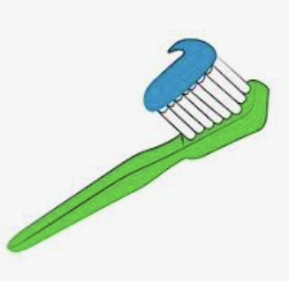
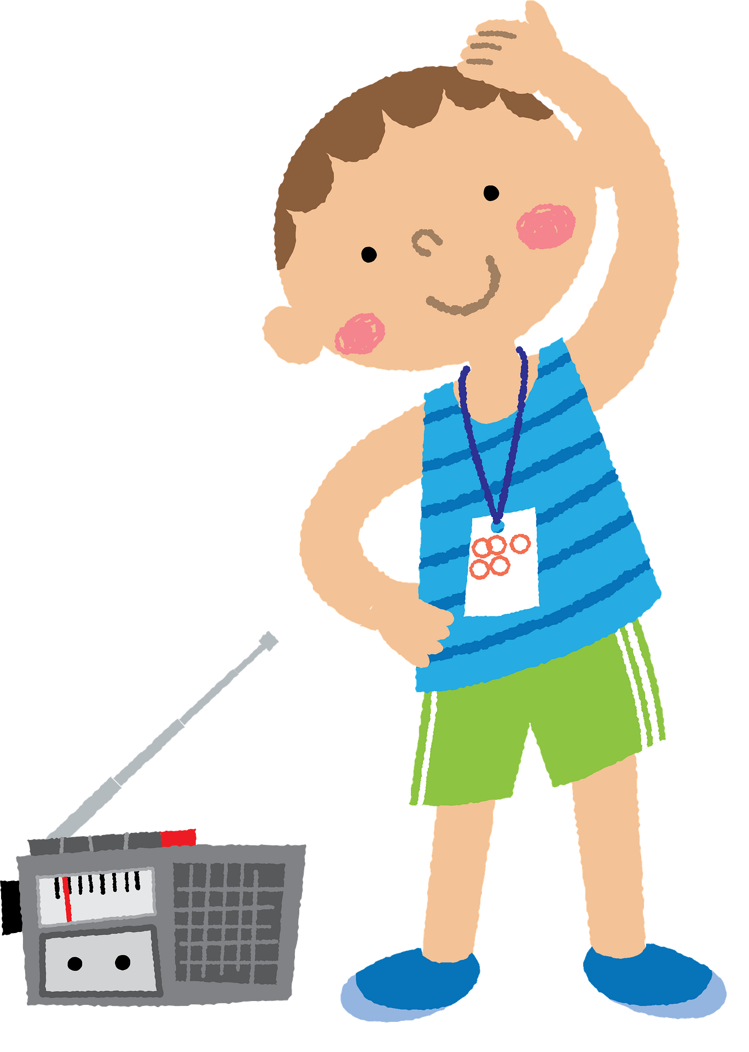
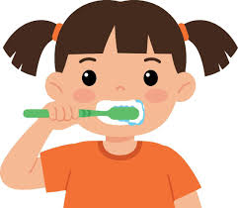
Healthy Me
Gold Class Knowledge Organiser
How to be healthy
Drink lots of water.
Get plenty of sleep.
Do exercise.
Clean your teeth.
Wash your hands.
Exercise and Hygiene
Pulse
Heart rate
Sweaty
Fitness
Clean
Hygienic
Wash
Healthy Eating
Fruit
Vegetables
Vitamins
Fat
Calcium
Protein
Diet
Balanced
Nutrition
Teeth
Decay
Plaque
Molars
Canine
Incisor
Gums
Dentist

