Slide 1
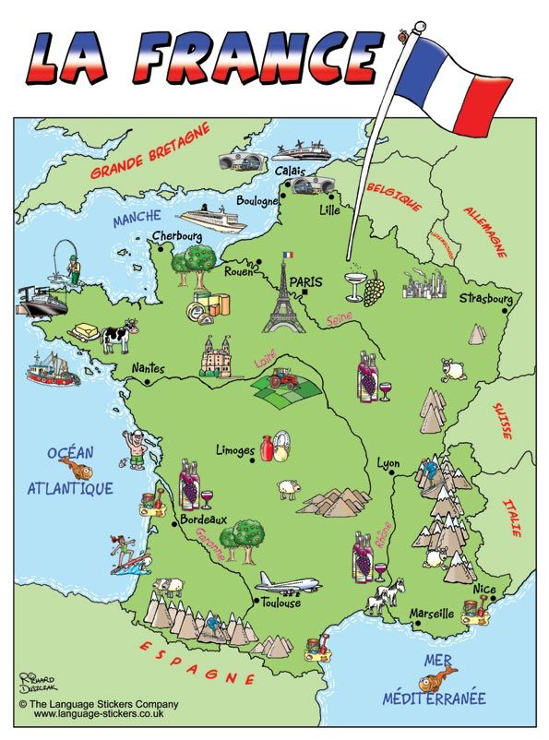
France / Geography Skills
Geography key words
map
globe
country
continent
capital city
town,
village
mountain
river
sea / ocean
Important Information
The Northern and Mediterranean sea surround France
Paris is the capital of France
The French flag is made up of blue, red and white stripes
The people speak French
France has a president not a king or queen - he is called President Macron
Topic words
French Key Words
France
Europe
Paris
Eiffel Tower
The River Seine
The Alps
Tricolore
French Food
baguette
crepe
croissant
hot chocolate
snails

Slide 2
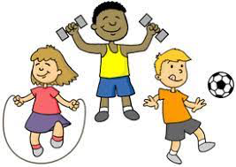
Science Homework Task Autumn 1
This half term our science topic is all about the human body.
Homework task
Create an exercise diary.
Pick a different exercise for each day e.g. 20 star jumps or running around the garden 5 times.
Write in your exercise diary what you do and how you feel.

