Slide 1
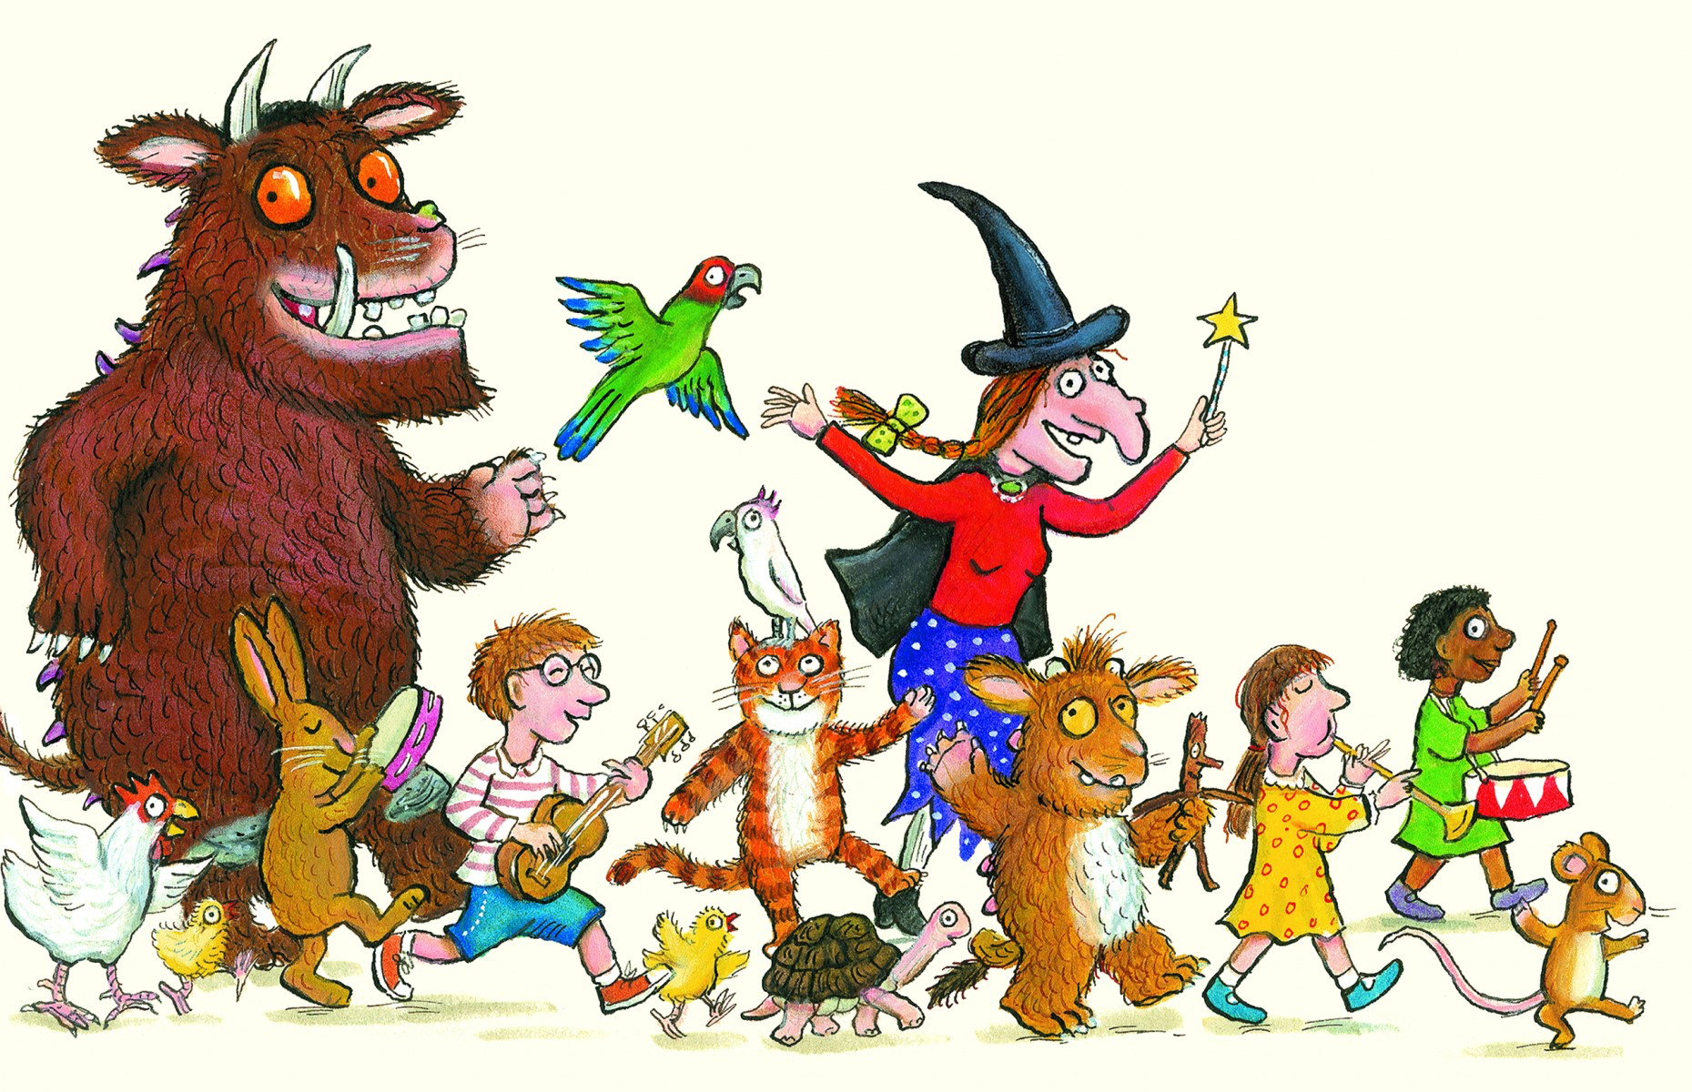
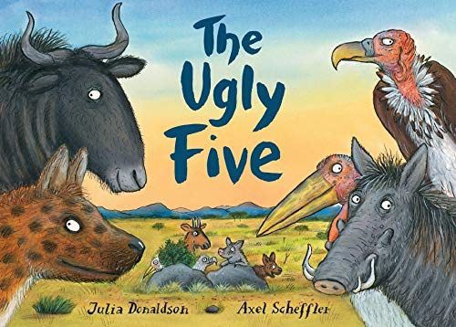
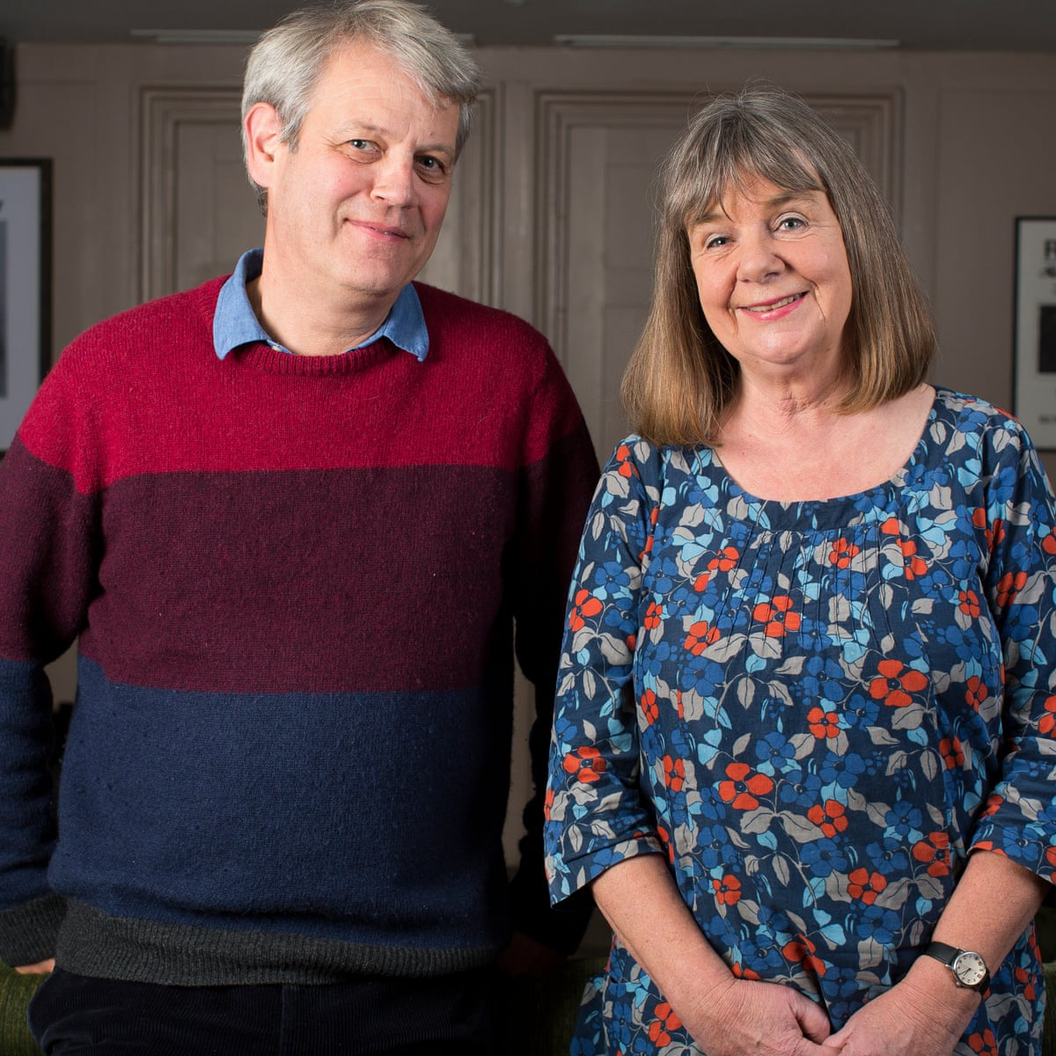
Books by Julia Donaldson Gold Class Knowledge Organiser
Story language
Once upon a time
They lived happily ever after
One fine day
There once was a …
Long long ago
Then one day
The Books
The Gruffalo
The Gruffalo’s Child
Stickman
The Room on the Broom
A Squash and a Squeeze
The Scarecrow’s Wedding
The Smeds and the Smoos
Monkey Puzzle
Zog
Charlie Cook’s Favourite Book
Tiddler
The Highway Rat
Superworm
The Ugly Five
Important People
Author
Illustrator
Julia Donaldson
Axel Scheffler
Questions to ask when reading the stories
Who is in the story? Who are the characters?
Where is the story set?
What happens in the beginning, middle, end?
What are the rhyming words?
What does …….. mean?
What is your favourite part of the story? Why?

