Slide 1
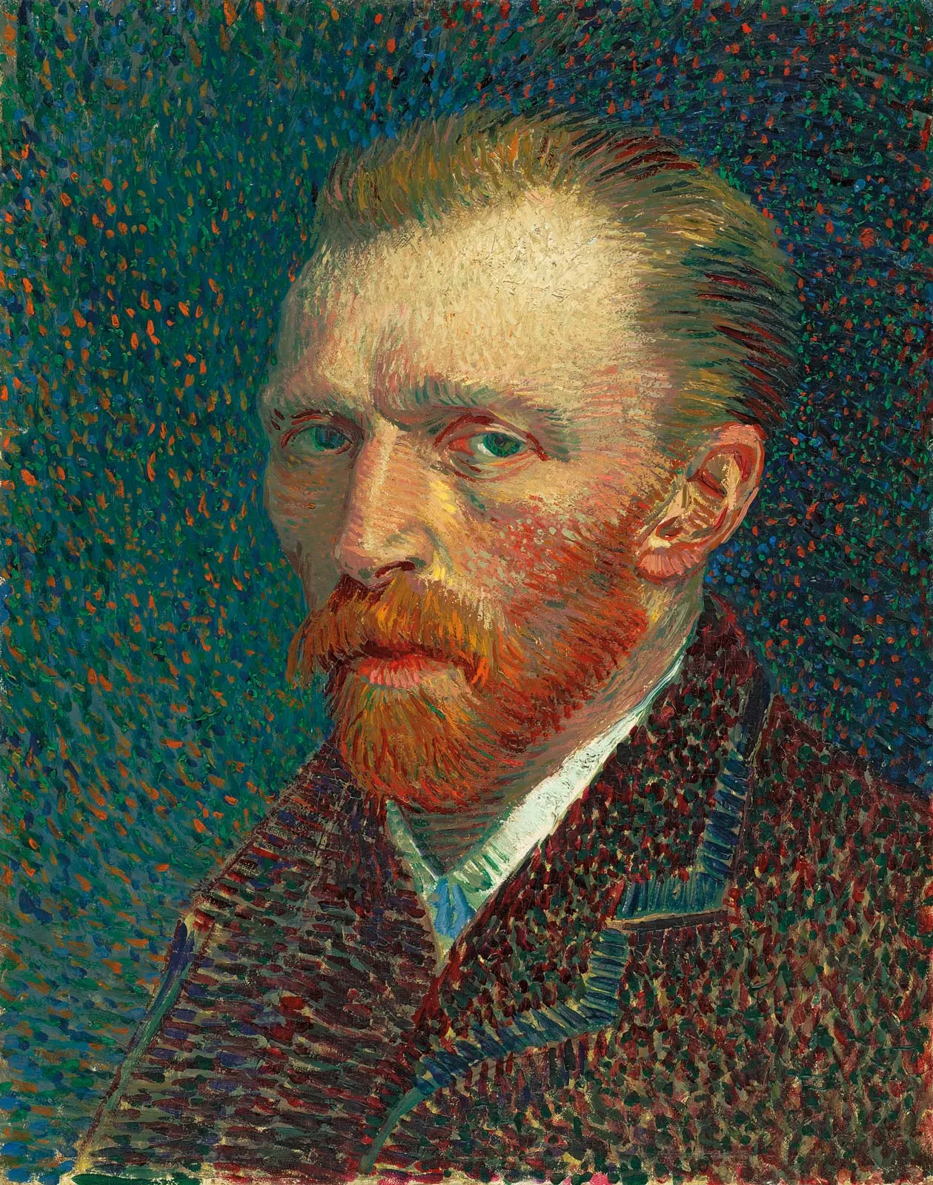
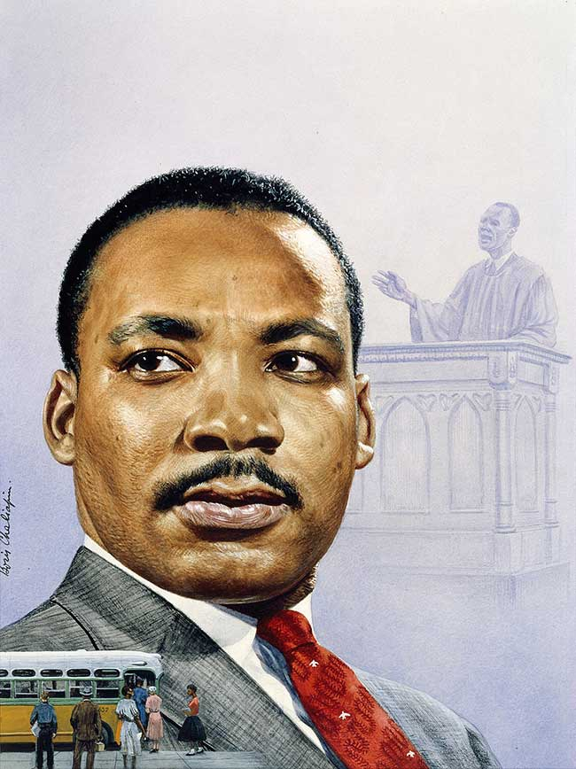
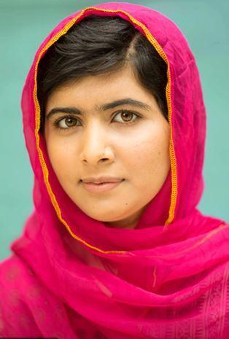
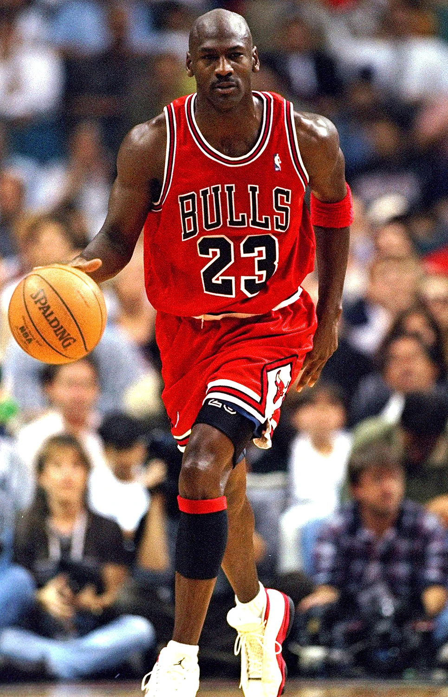
In the Spot Light
Vincent Van Gogh
Artist
Not alive anymore
Lived in Holland
He painted Sunflowers, Starry Nights
He painted portraits of himself.
Topic words
Martin Luther King
Minister
Not alive anymore
Born in America
He wanted things to be fair for black people.
He died when someone killed him.
Malala Yousafari
School girl
Still alive.
Born in Afghanistan
She wasn’t allowed to go to school because she was a girl.
She was very seriously hurt.
.Michael Jordan
Basketball player.
Still alive
Born in America
He has sportwear named after him.
He was in a film with Bugs Bunny.

