Slide 1
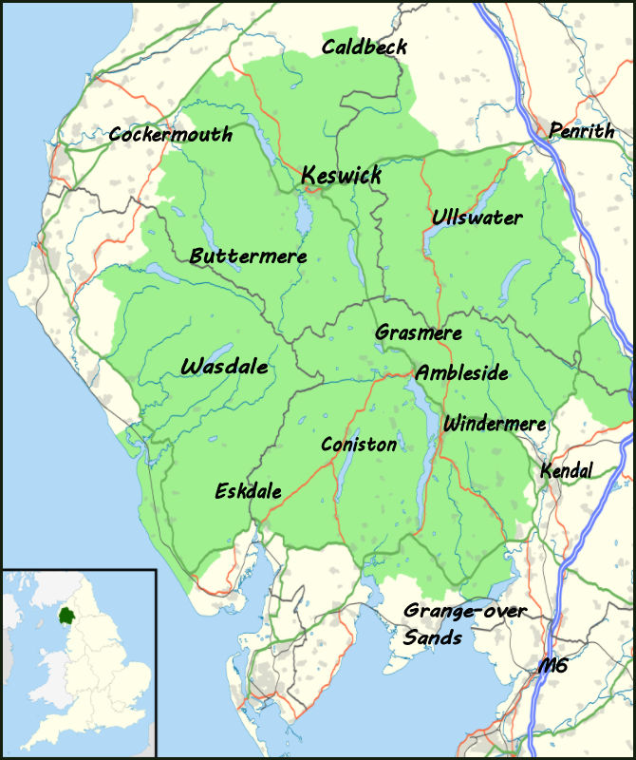
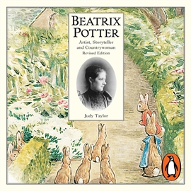
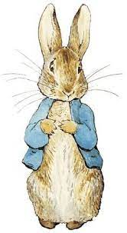
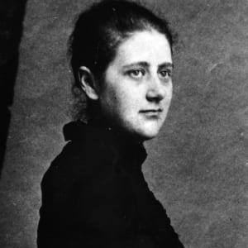
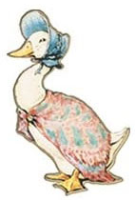
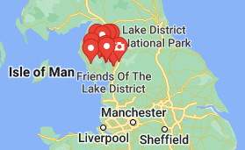
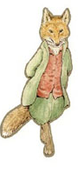
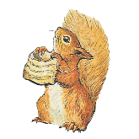
Year 4 knowledge organiser. What’s over the hills? Summer 2
Where is the Lake District?
The Lake District is a region and national park in Cumbria in northwest England. A popular vacation destination, it’s known for its lakes, mountains and historic literary associations.
The world Heritage Site is home to Scafell Pike - the highest mountain in England and the largest natural lake, Windermere. The Lake District is also known for it’s thriving local communities such as Keswick and Bowness-on-Windermere.
Key words
Terrain | A stretch of land, especially with regard to its physical features
National park | An area of countryside, or occasionally sea or fresh water, protected by the state for the enjoyment of the general public or the preservation of wildlife.
Tourism | The commercial organization and operation of holidays and visits to places of interest.
peak | The pointed top of a mountain.
Mountain | A large natural elevation of the earth's surface rising abruptly from the surrounding level; a large steep hill.
Who is Beatrix Potter?
Lake District facts. Did you know?
Helen Beatrix Potter was an English writer and illustrator, best known for her children's books.
As a child she had numerous pets and spent holidays in Scotland and the Lake District, where she developed her love for painting and writing.
There's only one actual lake in the Lake District.
It rains on average 200 days a year.
It is England's largest National Park.
It's home to England's deepest natural lake and the UK's largest natural lake – Lake Windermere.
It is home to many types of wildlife. Including, Red squirrels!
It is famous for England's highest peak – Scafell Pike.
Who are the characters?
Beatrix Potter wrote 24 children's tales and brought to life many beloved animal characters, including: Peter Rabbit, Jemima Puddle-Duck and others.
Lake district to Warrington.
The Lake District is around 100 miles from Warrington. It has a rough and rocky mountain terrain, which was created thousands of years ago due to intense volcanic activity!
“There is something delicious about writing the first words of a story.” – Beatrix Potter

