Slide 1
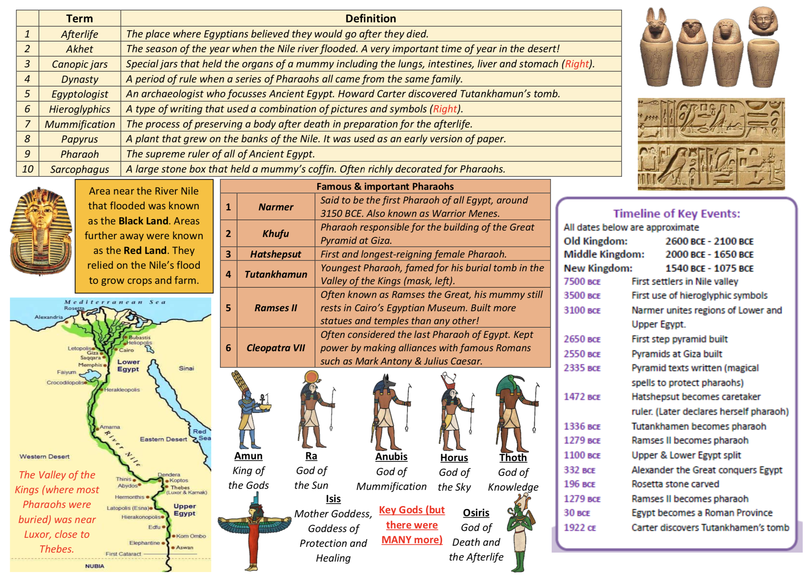
Y4 – Ancient Egyptians

