Slide 1

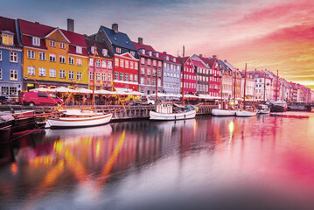
Opal Homework – Autumn 2
This term our topic is called Northern Exposure – Denmark
Geography Locate Denmark on a map. Draw the outline of Denmark and plot any famous landmarks or places. Make sure you use a key to identify symbols used. | Get active How many members of your family and friends can you get together to complete a Danish activity challenge? Keep a record of your achievements and share them with the class. | Writing Write a poem inspired by a Hans Christian Andersen story. Will it rhyme? Will it be funny or informative? | Writing Create a persuasive poster for visiting Denmark. Which landmarks will you use? Why not look at travel brochures to see how persuasive language is used?
Art Create your own Little Mermaid artwork for our class display. Paint, draw, sculpt or collage and get creative. | PE. Which sports are Denmark well known for? Can you create an information poster about them? | Maths Plan a holiday to Denmark. What attractions would you visit? Create a budget including travel, food and accommodation costs. | Art/Literacy Can you create your own comic strip based on a Hans Christian Andersen story? Include speech bubbles and illustrations.
Writing Create a fact file to show off some interesting facts about Denmark and Danish culture. What will you find out to share with us back in school? | Free style Can you create your own Danish menu? What traditional Danish foods can you find out about? | Literacy Write a diary entry as a character from a Hans Christian Andersen story. | Science Using recycled cardboard boxes, elastic bands, paper and string, can you create your own Viking long ship?
What? You can choose as many tasks as you like, making sure you take photos or record any writing, if you need a book or paper to record on, just ask! Some tasks are more of a challenge, if you do a good job you can earn extra diddy-dots!
When? Return on Tuesday 15th December for marking and a reward!

