Slide 1

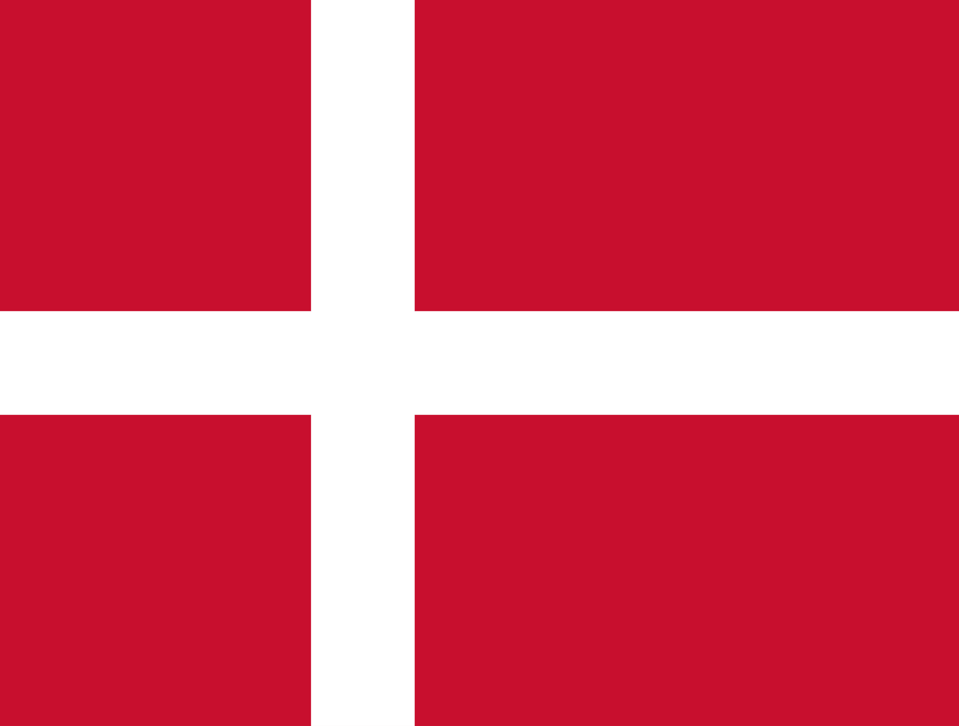
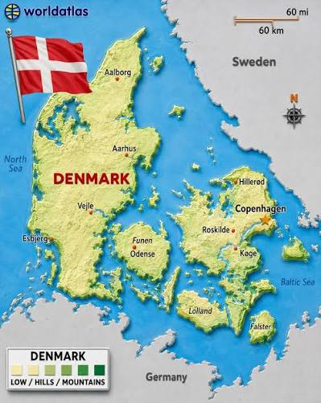
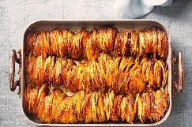
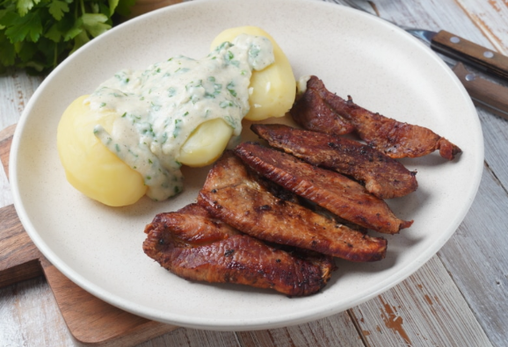
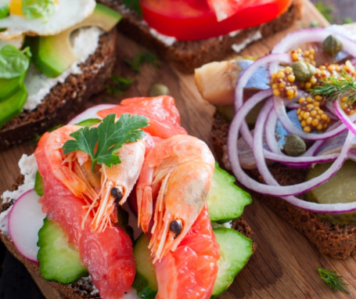
In Year 5 our geography topic is ...
Danish flag
Vocabulary | Meaning
Weather | The condition of the atmosphere in an area over a short period of time.
Climate | The weather conditions of a region over a long time.
Denmark | A country in Northern Europe made up of many islands.
Wind turbine | A tall structure with large blades that uses wind to generate electricity. Denmark is famous for using wind power.
Harbour | A sheltered area where boats and ships can dock safely.
Copenhagen | The capital city of Denmark and the country's largest city.
Baltic Sea | A sea located to the east of Denmark.
Key Information
Currency: | Danish krone (DKK)
Language: | Danish
Religion: | Christianity – mainly Lutheran (Church of Denmark)
Continent: | Europe
Capital city: | Copenhagen
Flight time: | It would take around 2 hours to fly from Manchester to Denmark.
Danish Foods: | Smørrebrød (open sandwiches), meatballs (frikadeller), pastries, pork dishes, rye bread, hot dogs
Exports: | Medicines, machinery, food products, wind turbines, furniture, and technology
Constitution Day (Grundlovsdag): | A Danish celebration held on 5th June to mark the signing of Denmark's constitution.
Countries that border Denmark: | Germany
Water surrounding Denmark: | North Sea and Baltic Sea
Denmark’s Geography
Danish food
Denmark is a small country in northern Europe and is part of a region called Scandinavia. It is made up of a peninsula called Jutland and over 400 islands. The capital city is Copenhagen. Denmark is known for its long coastline, colourful buildings and use of renewable energy, especially wind power.
Most people speak Danish and the country is surrounded by the North Sea and the Baltic Sea. Denmark is one of the happiest countries in the world and has strong links to the United Kingdom through history, trade and culture.

