Slide 1
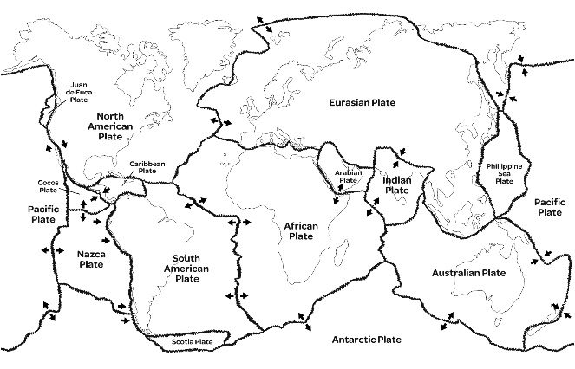
Is The Earth Violent?
Knowledge Organiser
Key knowledge
The Earth is made up of layers. The top layer, the Earth’s crust, consists of large slabs of rocks, called plates. The plates move as the hot mantle flows beneath them. The movement of the plates causes earthquakes and leads to volcanoes erupting. Earthquakes are measured on the Richter scale, They can cause devastating damage to buildings, roads and land. When volcanoes erupt, they spew out lava. This is a very hot liquid that destroy anything in its path.
Key facts
Famous volcanoes: Soufrière (St Lucia, North America), Eyjafjallajökul (Iceland, Europe), Popocatépetl (Mexico, North America), Vesuvius (Italy, Europe), St Helens (USA, North America), Etna (Italy, Europe).
Glossary
dormant: a dormant volcano is a volcano, like Kilimanjaro, that has not erupted for a long time epicentre: where an earthquake starts and is felt most strongly tsunami: a huge, powerful wave caused by an earthquake
Place names | Geographical terms and processes | Locational terms
Mount Vesuvius Haiti Iceland Japan Mauna Loa Pacific Ring of Fire | crater disaster dormant eruption magma tsunami | epicentre plate boundary
Did you know?
Volcano comes from the Roman word ‘Vulcan’ which is the name of the Roman God of fire!
What will we be learning?
The structure of the Earth. Features of a volcano. Famous volcanoes and earthquakes. Effects of volcanoes and earthquakes. Preparing for an earthquake. What it’s like living near a volcano.

