Slide 1
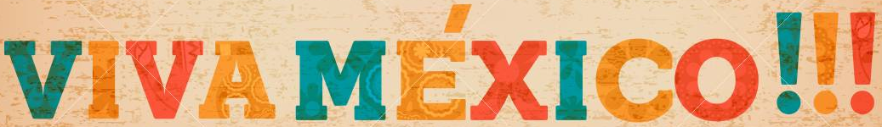
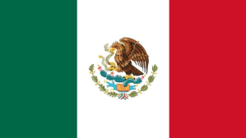
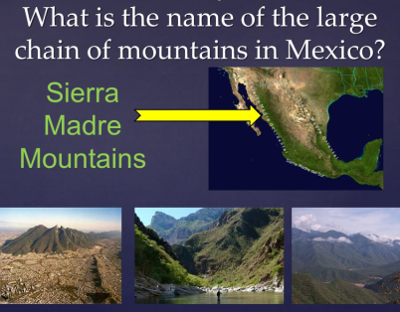
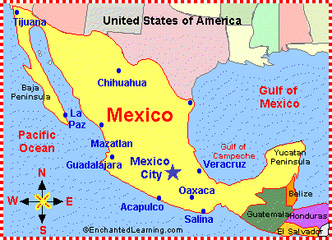
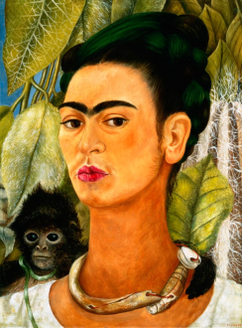
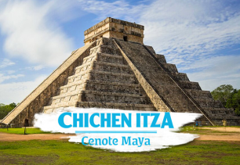
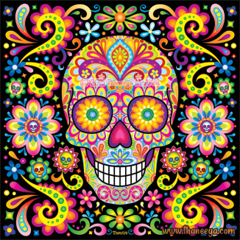
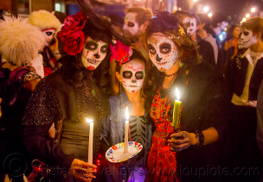
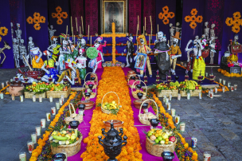
In Year 4 our geography topic is ...
Mexican flag
Key Information
Currency: | Mexican peso & US dollar
Language: | Spanish
Religion: | Christianity – Roman Catholic
Continent: | North America
Capital city: | Mexico City
Flight time: | It would take between 13 and 21 hours to fly from Manchester to Mexico.
Mexican Foods: | Nachos, tortilla, guacamole, chili con carne, enchiladas, burritos, tacos
Exports: | Corn, oil, fruit, vegetables, silver, coffee, cotton
Day of the Dead (Dia de la muertos ) | A Mexican festival that runs from 31st October – 2nd November to celebrate the life of the dead.
Countries that border Mexico: | USA, Guatemala and Belize
Water surrounding Mexico | Pacific Ocean, Gulf of Mexico and the Caribbean Sea
Mexico’s Geography
Vocabulary | Meaning
Weather | The condition of the atmosphere in an area over a short period of time.
Climate | The weather conditions of a region over a long time.
Dia de la Muertos | Traditional Mexican festival, which celebrates the lives of the dead.
Exports | The goods or services sent to other countries for money.
Human geography | An area of geography, which focuses on how humans have changed the Earth’s surface.
Physical geography | An area of geography, which focuses on the Earth’s nature features, such as mountains, deserts, rivers and oceans.
Region | A certain area in the world.
Map of Mexico showing surrounding sea and Oceans.
Mexican people & culture
Skulls are often decorated to celebrate the Day of the Dead festival
Ancient Maya city of Chichen Itza, meaning "water well of the Itzan people”. It is built around sinkholes near Yucatan and was a great place of worship.
Frieda Kahlo – famous Mexican Artist
Day of the Dead
The Day of the Dead is celebrated in Mexico and other
parts of Latin America. It is known there as Día de los
Muertos. Even though it is celebrated in Mexico,
people also celebrate the festival in other countries
as well.
The festival is celebrated to remember loved ones
who have died and It also helps people accept and
deal with the idea of death. An elaborate festival
takes place from October 31st to November 2nd
every year.

