Slide 1
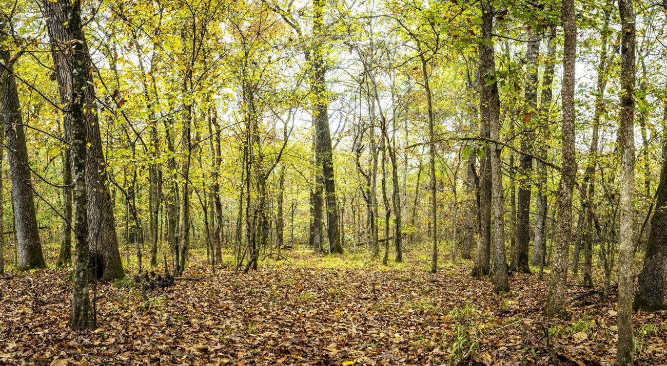
Opal Homework – Spring 2
This term our topic is all about ‘Twisted Tales’
Writing Create a word bank of synonyms for said. How many can you find? | Get active How many members of your family and friends can you get together to organise a mini sports activity? Take lots of pictures to show everything you do. | Writing Write a poem with an Egyptian theme. Will it rhyme? Will it be funny or informative? | Writing Write a short story about Snow White but change one of the key parts in the story. What will the twist be?
Art Create your own 3D model of a spooky forest our class display. Recycle materials you find at home. Paint, mould, sculpt and get creative. | PE. Can you create a new game to play in the playground in school? What are the rules? Do you need any equipment? How do you earn points? | Maths Plan a party for your family and friends. What would you need to buy? How much would you have to spend to get what you needed? | Art/Literacy Draw your favourite villain from a children’s movie and add a character description explaining their features in detail.
Writing Draw and write a comic strip for a twisted tale called ‘’Goldilocks and the three dinosaurs’’. | Free style What interests you the most? Bugs? Dragons? Cars? Mythical beasts? People? Create a short story with your item/person being the main character. | Literacy Write a recount of something exciting you have done over one weekend. | Art Heard of the story ‘Jack and the Beanstalk’? Instead of a giant and a golden egg can you rewrite the story and use different elements to the story?
What? You can choose as many tasks as you like, making sure you take photos or record any writing, if you need a book or paper to record on, just ask! Some tasks are more of a challenge, if you do a good job you can earn extra diddy-dots!
When? Return for a reward on

