Slide 1
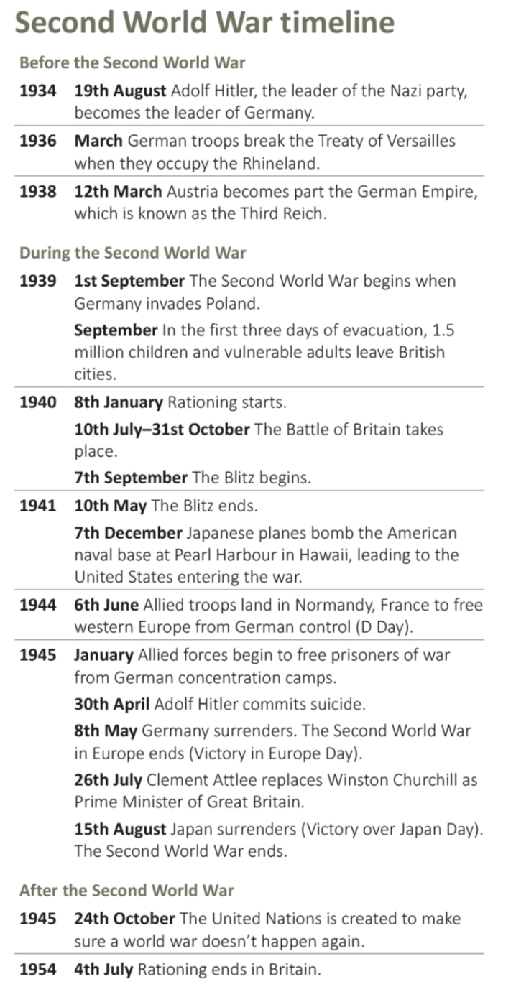
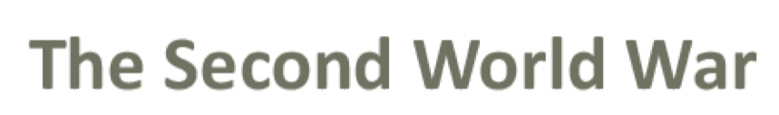


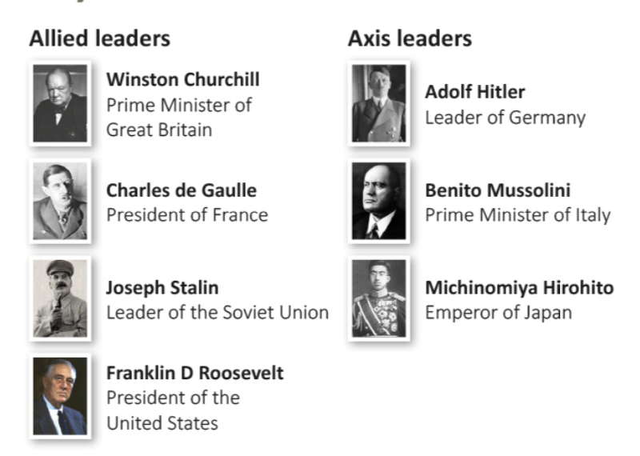
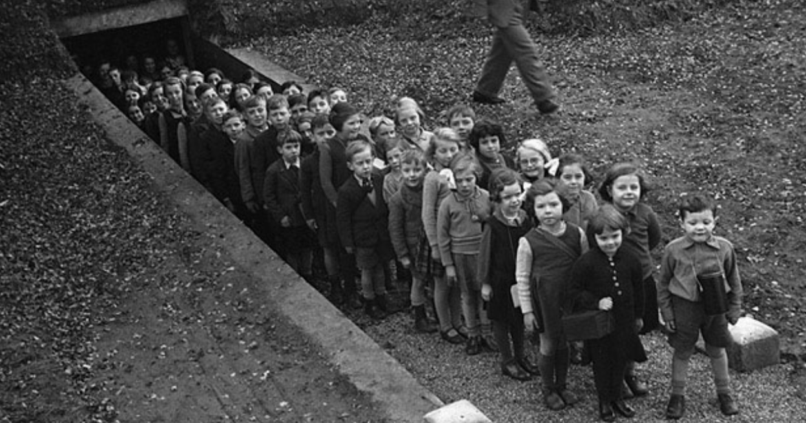
A Child’s War
Year 4 Knowledge Organiser
Key vocabulary
Adolf Hitler – leader of Germany throughout World War 2.
Air raid – an attack in which bombs are dropped from aircraft on to a ground target.
Blackout – when towns or cities were made so dark that they cannon be seen by enemy planes.
Evacuee – a child or vulnerable adult who was sent away from a city to live in the countryside, which was considered safer.
Invade – to entry or occupy a country by force
Nazi – a follower of Adolf Hitler, leader of the Nazi party.
War – a state of armed conflict between different countries.
Rationing – the limited supply of food, clothes and other goods to prevent shortages.
The Second World War lasted from 1939-1945.
One one side were the Axis Powers (including Germany, Italy and Japan).
On the other side were the Allied Powers (including Britain, France, the Soviet Union and the USA).
After 6 years of fighting, the Allied Powers won.
During World War II, over 3.5 million children, were evacuated from the cities to the countryside.
All evacuees had to take their gas mask, ration book and identity card.
When they reached their destination, a billeting officer would arrange a host family for them.
Evacuation happened in waves, beginning on 1st September 1939.
Other waves occurred at the start of the Battle of Britain and at the start of the Blitz.

