Slide 1
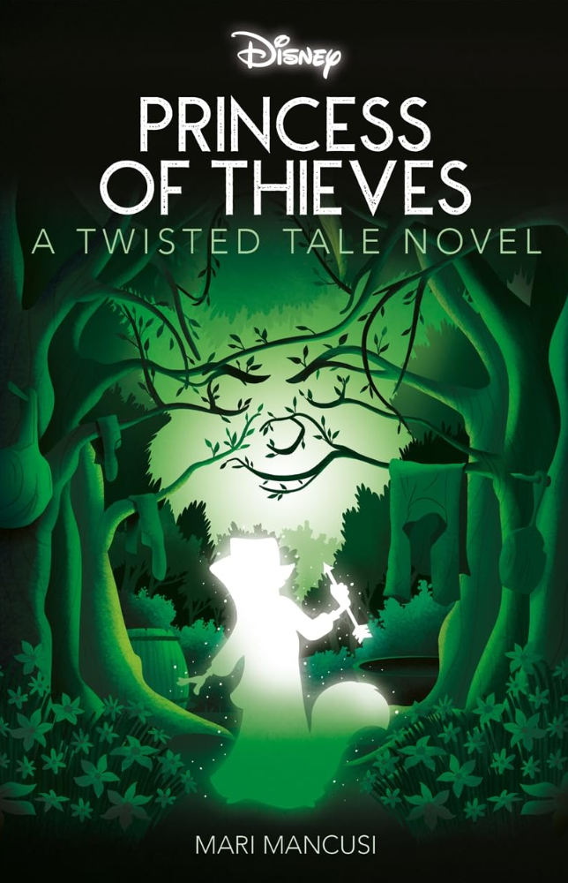
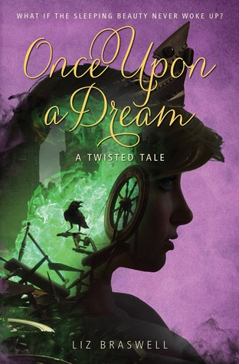
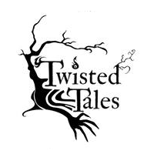
Twisted Tales
Knowledge Organiser - Opal class
What is a Twisted Tale?
  • A twisted tale is a traditional story that has been changed in a surprising way.
  • The characters, setting, problem, or ending might be different.
Key Features
  • Based on a familiar fairy tale
  • A clear twist (something changes!)
  • Includes a beginning, a middle and an end
  • Strong characters
  • Descriptive language and dialogue
Useful Vocabulary
  • twist
  • character
  • setting
  • problem
  • solution
  • narrator
  • predict
Twisted Tale Examples:
  • Little Red Riding Hood – the wolf is kind and tries to help.
  • The Three Little Pigs – the pigs are lazy and the wolf is hardworking.
  • Cinderella – the story is told from the step‑sister’s point of view.
Story Plot Steps:
  • Beginning: Introduce the characters and setting (like the original story).
  • Middle: Something changes – this is the twist!
  • Problem: A new problem appears because of the twist.
  • Ending: The problem is solved in a new or funny way.
Beginning
Twist!
Problem
Ending

Slide 2
How to Write a Twisted Tale (Story Plot)

