Slide 1
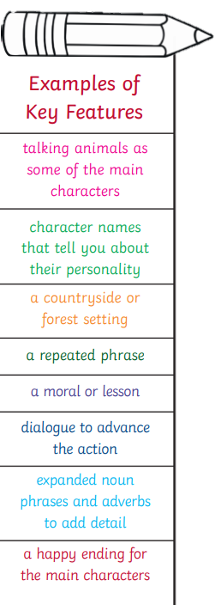
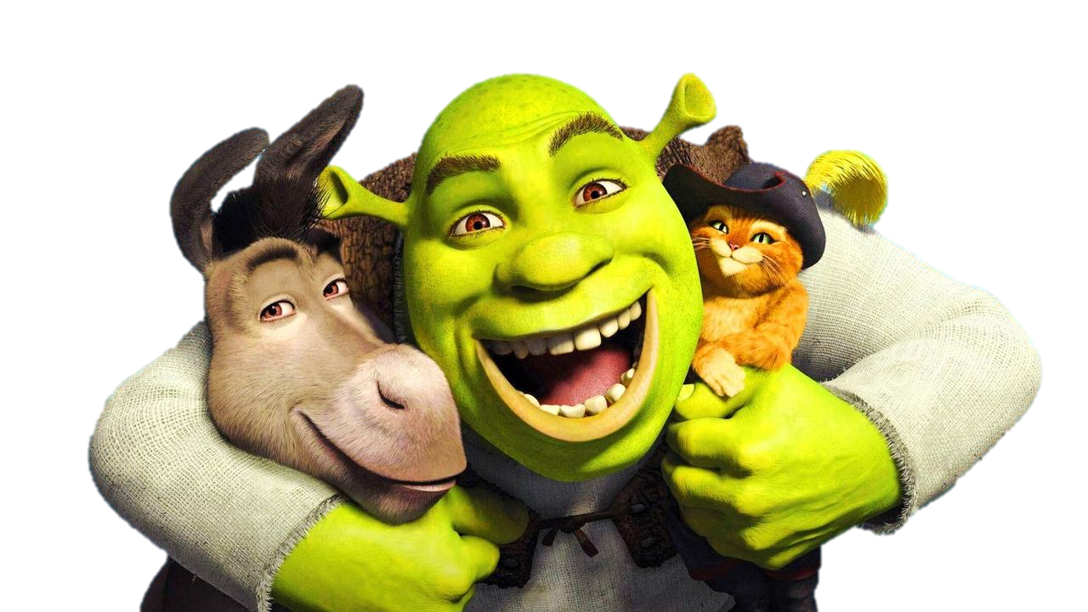
Year 5 Knowledge Organiser – Literacy unit Shrek’s Adventure
What are fairy tale stories?
Fairy stories are imaginary tales set in fantastical lands. Many include a battle between good and evil and usually end with the characters living 'happily ever after'.
Why Shrek?
Shrek sparked a motion picture phenomenon and captured the world's imagination with...the Greatest Fairy Tale Never Told! Here, Shrek goes on a quest to rescue the feisty Princess Fiona with the help of his loveable Donkey and win back the deed to his swamp from scheming Lord Farquaad. Along the way we are introduced to many fairy tale characters who will be inspiring our writing for the term.
How to write a fairy tale that enchants your readers:
Once Upon A Time… ...
Choose Your Fairy Tale Moral. ...
Create Your Characters. ...
Consider Your Conflict. ...
Hone In On Your Happy Ending. ...
Decide On Your Settings. ...
Sprinkle In Some Magic.
What are the 5 main elements to a fairy tale story?
1: the moral lesson.
2: characters.
3: magic.
4: obstacles or tasks.
5: happily ever after...

