Slide 1
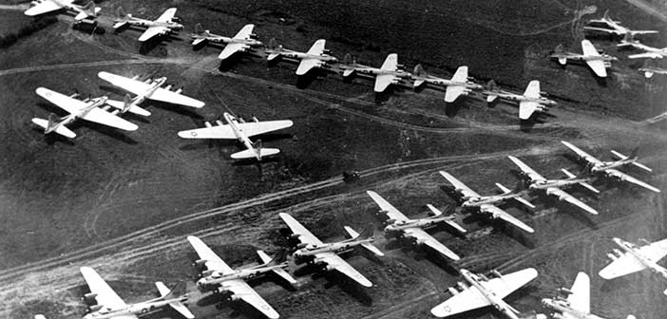
Opal Homework – Summer 1
This term our topic is all about WW2 & Warrington
Geography Search Google to look at images of Warrington in 1940 and images of Warrington from the present day. Can you see any landmarks or building that have stayed the same or even changed? Write about the differences and similarities that you see. | Get active Look at war time dances and songs that children would of learnt and danced too. Choose one and learn the dance for it. | Writing Look up the history of how the roads and streets on Chapelford Village got their names. Can you write a list of the top ten interesting street names, and include the facts about what it is named after. | Writing This involves you completing some research about life in the 1940’s. Imagine you lived in Warrington during the 1940’s. I’d like you to describe what the different rooms in your house would have looked like?
Art Use your art skills to create a well drawn image of an object from your house. Add different mark making techniques to create shading. Think about scale, shape and proportion. | Literacy/Fun Research the history of Risley and its connection with the women of WW2. Write a fact file to let us know what you have found out. | Maths Create your own multiplication facts wall poster for your room. Ask me for an A3 piece of paper to create your poster on.(I have different coloured paper if you’re quick to ask for it) | Art/Literacy Research propaganda posters from WW2. Can you choose one of your favourites and recreate it?
ICT Create a fact file to display your top ten interesting facts about WW2. Make sure you add images and change the style of font to make it look more appealing. | Free style Recycle an old item of clothing to create something new. Look up Make do and mend – a campaign used when there were shortages of clothing. | Literacy Write a diary entry about your weekend. What did you get up to? How did it make you feel? | Science Choose a creature that you are interesting in and turn an old shoe box into a diorama to show what it’s habitat would look like.
What? You can choose as many tasks as you like but make sure you take photos or record any writing. If you need a book or
paper to write on, just ask! Some tasks are more of a challenge, if you do a good job you can earn extra diddy-dots and house points!
When? Return for marking and a reward on Monday 20th May 2024

