Slide 1

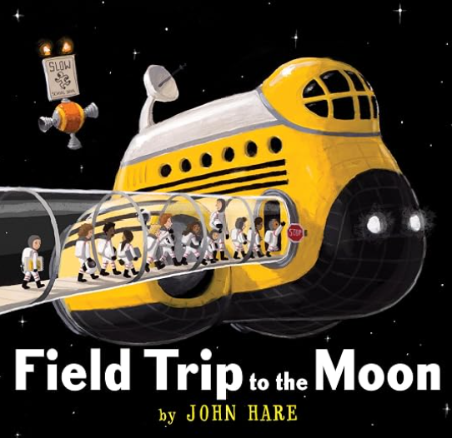




Y2 Knowledge Organiser – Autumn 1
History – Moon Zoom!
In this history unit, we will be finding out all about the Space Race and the challenge to put humans on the moon. We will find out about the period in history when this took place and also about three very famous astronauts.
We will find out about the first moon landing and why it was “one small step for man, one giant leap for mankind”.
What we are reading this half term:
English
We will be reading lots of books linked to our history topic of space. We will enjoy reading and retelling stories with a space theme. We will also read non-fiction books about space and we will look at lots of books about materials.
History Vocabulary | Definition
Astronauts | A person who travels into space to explore or do research.
Apollo 11 | The name of the first spacecraft that took humans to the moon in 1969.
Neil Armstrong | The first person to walk on the moon during the Apollo 11 mission.
Launched | When a rocket or spacecraft is sent into the sky and into space.
Mission | A special journey or task that astronauts go on to explore space or do experiments.
The Eagle | The name of the lunar module that took astronauts to the moon’s surface during the Apollo 11 mission.
Command module | The part of a spacecraft where astronauts sit and control the mission .
Sputnik | The first satellite sent into space in 1957.
Mathematics
This half term, we will be learning to:
Read and write numbers to 100 in numerals and words.
Count in steps of 2, 3, 5 from zero, forwards and backwards.
Count in steps of ten from any number forwards and backwards.
Recognise the place value of any digit in a 2 digit number.
Compare and order number from 0-100 using <, >, =.
Use place value and number facts to solve problems.
Identify, represent and estimate numbers using numberlines.
Science - Materials
In Science, we will explore materials. We will find out the names of some common materials as well as the properties of these materials. We will also find out how some of these materials can be changed.
Science Vocabulary | Definition
Flexible | Able to bend, stretch or change without breaking.
Rigid | Difficult or impossible to bend, not flexible.
Natural | A material that comes from nature.
Manufactured | Materials created by humans, not found in nature.
Material | The thing an object is made from, such as wood, plastic.

