Slide 1


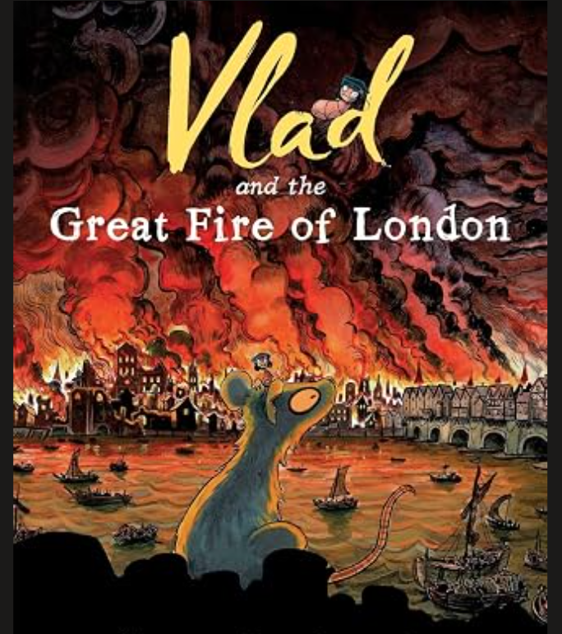
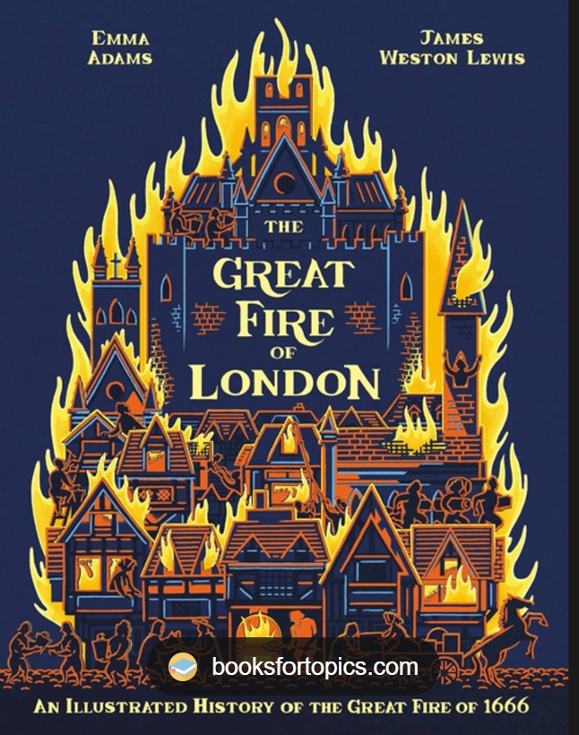
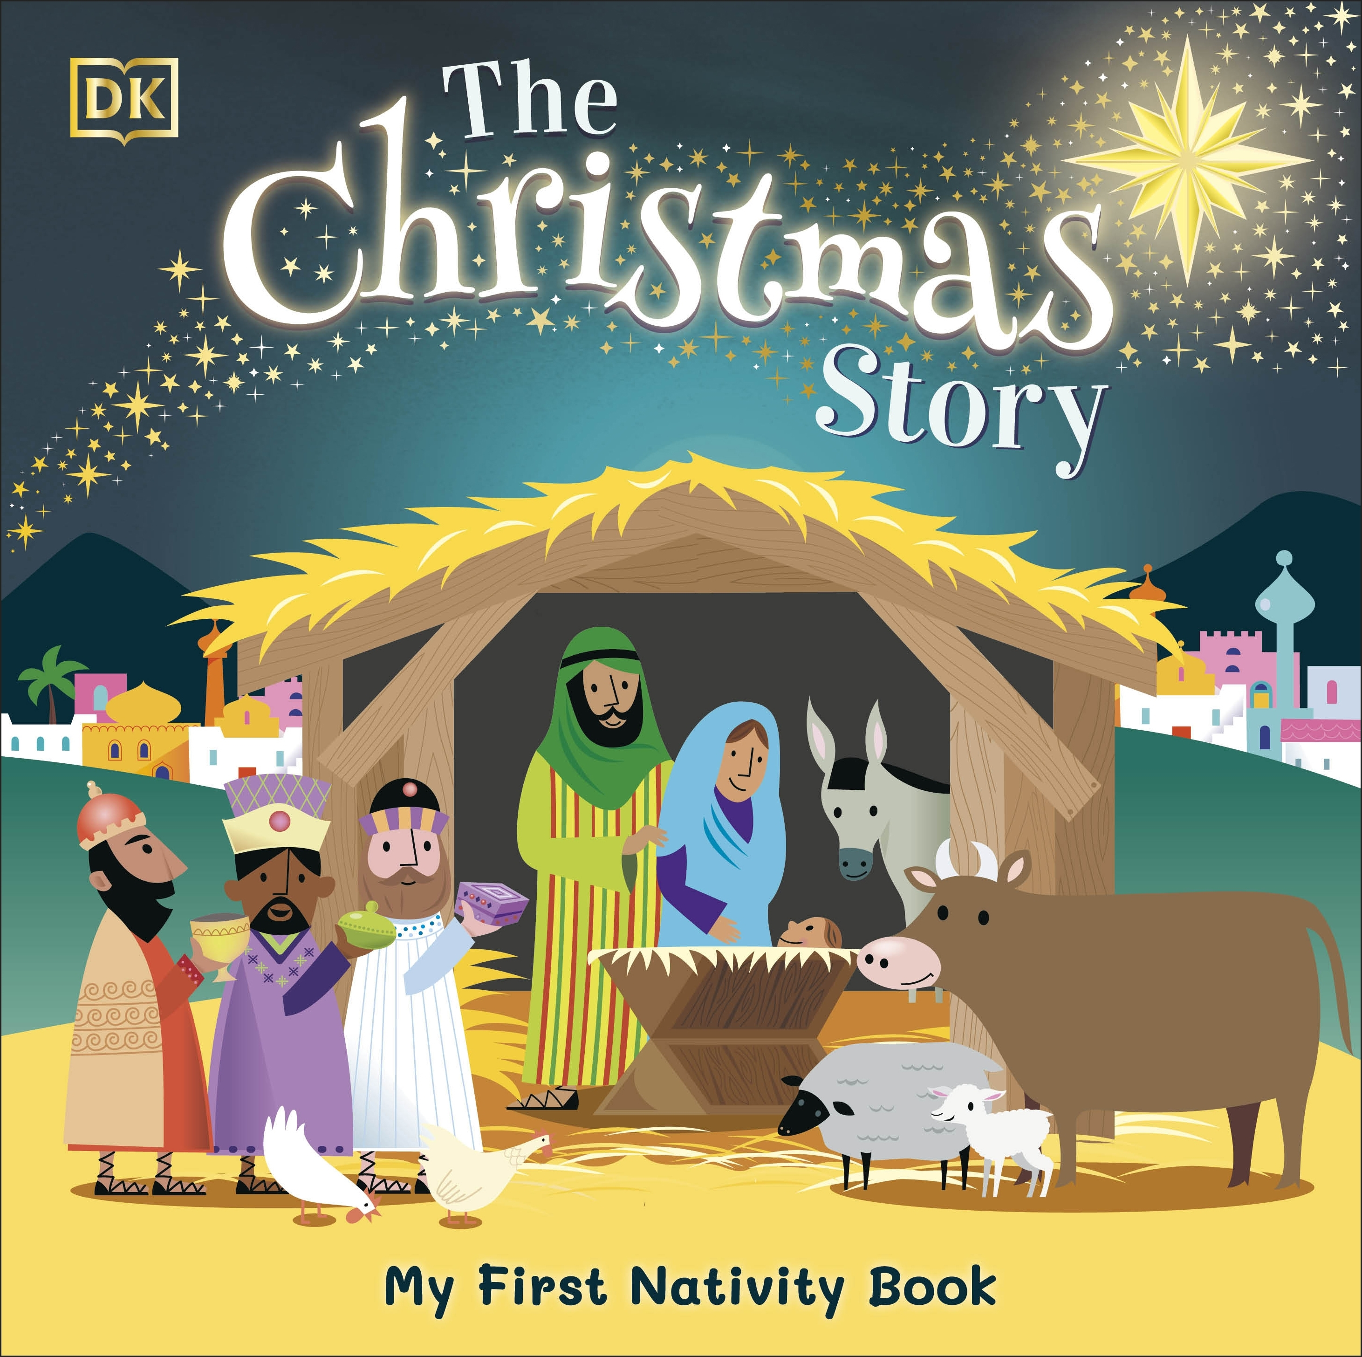
Y2 Knowledge Organiser – Autumn 2
History – The Great Fire of London
In this history unit, we will be finding out all about the Great Fire of London. We will find out when this event happened and why it happened. We will also find out about the people involved and the effect it had on the city.
We will also find out how this led to the creation of a fire service in our capital city.
What we are reading this half term:
English
We will be reading books linked to our history topic of The Great Fire. These will be information books as well as story books. We will also be reading books linked to Christmas, as we will be celebrating this festival at the end of this term.
History Vocabulary | Definition
London | The capital city of the UK.
Pudding Lane | The place where the fire started.
Firebreak | A gap in buildings to stop a fire spreading.
Eye witness | Someone who has seen an event and can describe it.
King Charles II | The king of England in 1666.
Samuel Pepys | A writer who saw the fire and wrote about it in his diary.
Thatched roof | A roof covered with straw.
Fire hooks | Large hooks used to pull down burning buildings.
Mathematics
This half term, we will be learning to:
Read and write numbers to 100 in numerals and words.
Count in steps of 2, 3, 5 from zero, forwards and backwards.
Count in steps of ten from any number forwards and backwards.
add numbers using concrete objects, pictorial representations and mentally, including a 2-digit number and ones.
Subtract numbers using concrete objects, pictorial representations and mentally, including a 2-digit number and ones.
Science - Materials
In Science, we will continue to explore materials. We will find out the names of some common materials as well as the properties of these materials. We will also find out how some of these materials can be changed.
Science Vocabulary | Definition
Flexible | Able to bend, stretch or change without breaking.
Rigid | Difficult or impossible to bend, not flexible.
Natural | A material that comes from nature.
Manufactured | Materials created by humans, not found in nature.
Material | The thing an object is made from, such as wood, plastic.

