Slide 1


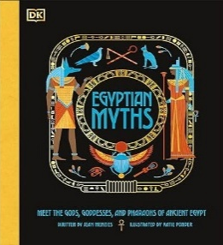
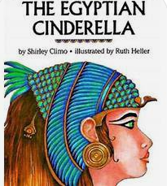
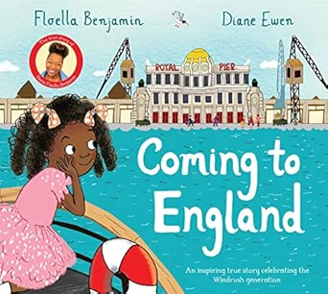
Ruby Class Knowledge Organiser – Autumn 1
History – Rulers of the River: Secrets of the Ancient Egyptians
In this history topic we will immerse ourselves in 3,000 years of history. Our classroom will become a tomb discovery site with hidden artefacts around the room.
We will explore the vital lifeline of the River Nile and how it allowed civilization to thrive.
We will decode messages using Ancient Egyptian Guides, investigate the gruesome process of mummification and construct pyramid models using Lego or sugar cubes.
What we are reading this half term:
English
Lots of our reading will link to our exciting history topic. We will use a range of fiction and non-fiction texts to inspire our writing. During this unit, we will write a third-person narrative retell, an explanation text and a biography.
History Vocabulary | Definition
Army | A military force for border defense, territorial expansion, and public works.
Afterlife | An eternal, perfect continuation of earthly life free from illness and death.
Ancient | A time period that existed in the distant past.
Artefact | An object made or used by humans that provides insight into their culture, daily life or religious beliefs.
Empire | The period of the New Kingdom (c.1570-1069 BCE)
Ruler | The ruler of ancient Egypt was called a pharaoh.
Temple | The ‘mansion of a god’ – a home for a deity on earth.
Scribe | A highly educated, civil servant responsible for reading, writing and maintaining official records.
Mathematics
This half term, we will be learning to:
Count in Hundreds and Twenty-Fives.
Use Place Value.
Compare and Order Numbers.
Make Number Patterns.
Round Numbers to the Nearest 1,000.
Round 4-Digit Numbers to the Nearest 10 or 100.
Round Numbers to Estimate.
Science – Living Things and Their Habitats
In Science, we will explore ‘Living Things and Their Habitats’. We will look at Life Processes and Grouping of Animals and Classification Keys.
Science Vocabulary | Definition
Amphibians | An animal born in water but develops lungs and lives on land later in its life.
Birds | A type of animal that has wings and is born from a hard-shelled egg.
Carnivore | Living things that only eats meat.
Herbivore | A living thing that just eats plants.
Omnivore | A living thing that eats both plants and meat.

