Slide 1


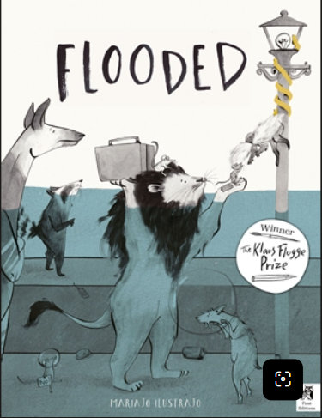



Ruby Class Knowledge Organiser – Autumn 2
Geography - Is the Earth Violent?
In Geography this half term, we will learn about the powerful forces of nature through our exciting topic, Is the Earth Violent? We will explore earthquakes (ground shaking), volcanoes (mountains that can erupt) and tsunamis (huge ocean waves), and find out how and why they happen.
We will learn about the layers (parts) of the Earth, explore where natural disasters (dangerous natural events) happen around the world and discover how they affect people and communities. We will also learn how people prepare (get ready) for these events and what they do to stay safe and recover (get back to normal) afterwards.
What we are reading this half term:
English
Lots of our reading will link to our exciting geography topic. We will use a range of texts to inspire our writing. We will develop our storytelling skills by retelling The Christmas Story, focusing on using interesting vocabulary, accurate punctuation and correctly formed sentences.
GeographyVocabulary | Definition
Tsunami | A very large ocean wave.
Volcano | An mountain that can erupt with lava.
Layers | The different parts of the earth.
Magma | Melted rock beneath the Earth’s surface.
Lava | Hot melted rock from a volcano.
Natural Disaster | A dangerous event caused by nature.
Earthquake | When the ground shakes.
Erupt | When a volcano explodes or releases lava.
Mathematics
This half term, we will be learning to:
Add and subtract numbers up to 10,000.
Use column addition and subtraction, including renaming (exchanging).
Develop mental strategies for addition and subtraction.
Recall and use multiplication facts, focusing on the 6, 7, 9, 11 and 12 times tables.
Use related division facts to solve problems.
Solve multiplication and division problems using different strategies.
Apply our knowledge to reasoning and word problems.
Science – Electricty
In science, we will learn about electricity and how it is used every day. We will explore circuits and learn how to connect batteries, bulbs and switches. We will find out which materials allow electricity to flow and which do not. We will then use our learning to make our own working torches.
Science Vocabulary | Definition
Electricity | A form of energy that powers devices.
Circuit | A complete loop that allows electricity to flow.
Conductor | A material that allows electricity to pass through it.
Insulator | A material that does not allow electricity to pass through it.
Energy | The power needed to make things work.

