Slide 1
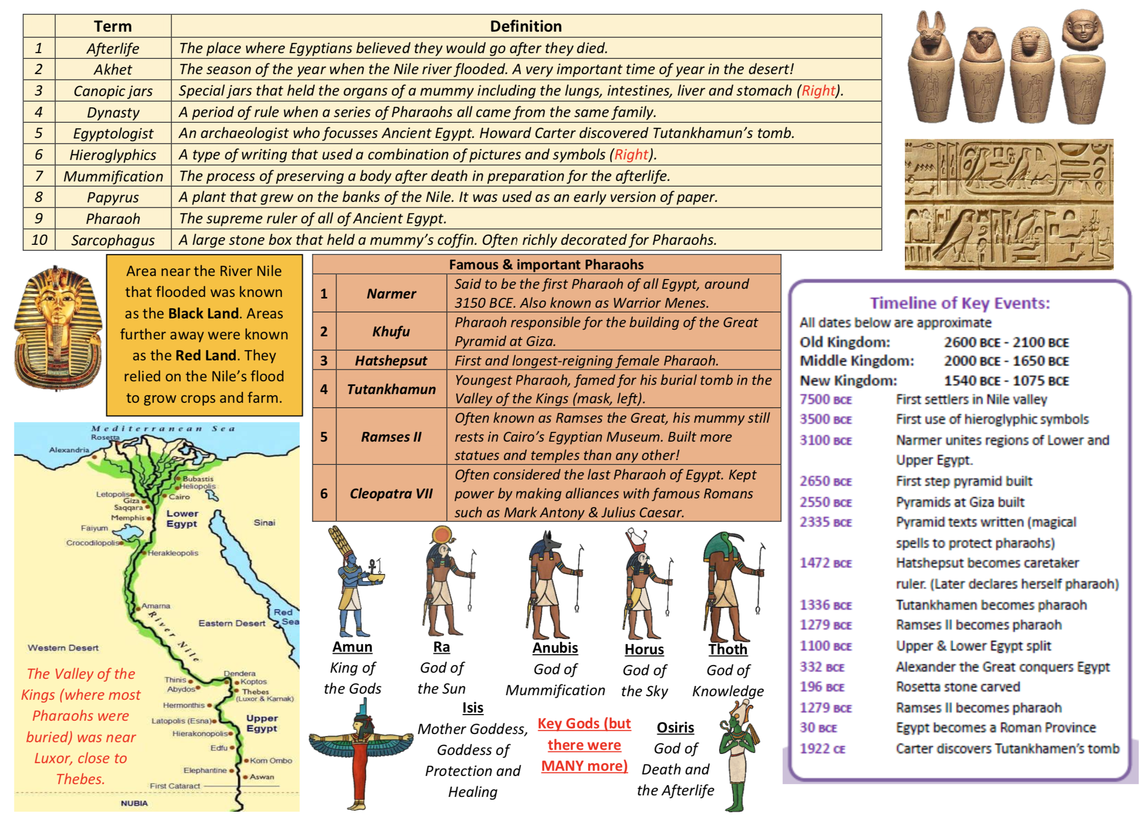
Y3/4 – Ancient Egyptians

