Slide 1
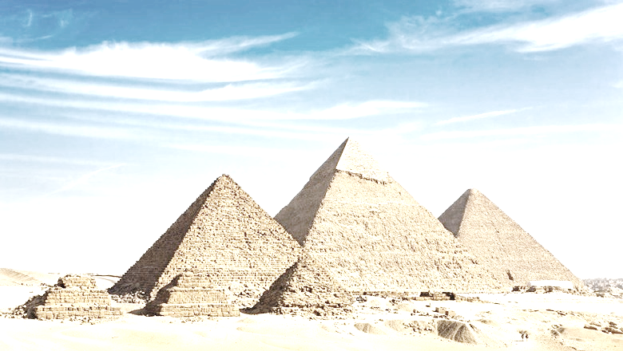
Jade Homework – Spring 1
This term our topic is all about Egypt
Geography Locate Egypt on a map. Draw out the outline of the continent it is found in and plot the famous landmarks of Egypt. Make sure you draw out a key to identify symbols used. | Get active How many members of your family and friends can you get together to organise a mini sports activity? Take lots of pictures to show everything you do. | Writing Write a poem with an Egyptian theme. Will it rhyme? Will it be funny or informative? | Writing Create a persuasive poster for visiting Egypt. Which landmarks will you use? Why not collect holiday brochures from a travel shop and cut out some of the images you find.
Art Create your own 3D model of a pyramid for our class display. Recycle materials you find at home. Paint, mould, sculpt and get creative. | PE. Can you create a new game to play in the playground in school? What are the rules? Do you need any equipment? How do you earn points? | Maths Plan a party for your family and friends. What would you need to buy? How much would you have to spend to get what you needed? | Art/Literacy Use hieroglyphics to write out your own name to make a door sign for your bedroom.
Writing Make a list of questions that you would like to ask an ancient Egyptian. What would you like to know? | History Create a fact file about a famous Egyptian. | Literacy Write a recount of something exciting you have done over the holidays. | Science Find 5 appliances in your house that use electricity and research which uses the most and the least.
What? You can choose as many tasks as you like, making sure you take photos or record any writing, if you need a book or paper to record on, just ask! Some tasks are more of a challenge, if you do a good job you can earn extra diddy-dots!
When? Return week beginning 3rd February for marking and a reward!

