Slide 1
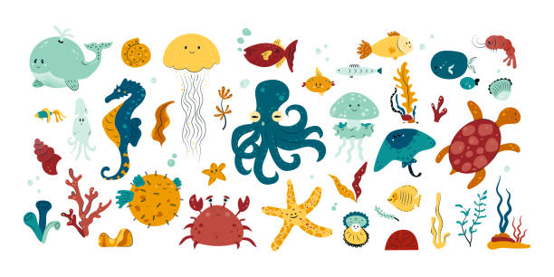
Jade Homework – Spring 2
This term our topic is all about Michael Morpurgo – Sea Stories
Geography Use a world map and label the world's oceans. | Get active Enjoy a visit to the beach or a swimming pool and take a relaxing swim. | Writing Write an under the water themed story. Remember to use lots of exciting adjectives. | Writing Create a fact file about your favourite sea creature. Remember to include pictures, diagrams, and fun facts too.
Art Create a sand art picture to make a sea / beach scene OR use different materials to create a sea collage. | PE. Practice in the water being different sea creatures using the movements of creatures such as: jellyfish, octopus, sea turtle, dolphin, shark and fish. | Maths Research the lengths of a variety of sea creatures and order them from smallest to largest. | Art/Literacy Create your very own TOP TRUMPS cards about the sea creatures you have learned about in the previous tasks.
Writing Make an acrostic poem about your favourite sea creature. | Writing Write a recipe for a seafood dish and become a cook and make it at home for your family to sample. | Literacy Create your own quiz about under the sea and water creatures. Then, your family and friends to complete it. We can even complete it in school! | Science Make a boat out of 2 different materials, such as paper and tin foil and test which one floats better.
What? You can choose as many tasks as you like, making sure you take photos or record any writing. If you need a book or paper to record on, just ask! Some tasks are more of a challenge so if you do a good job, you can earn extra diddy-dots!
When? Return week beginning 24th March for a reward!

