Slide 1
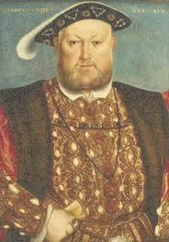
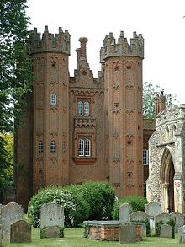
Sapphire Homework – Summer 1
This term our topic is all about Tudor Explorers
Geography If you could go on a voyage, where would you go? Show your route on a world map and label the countries that you would pass through. | Get active Create a treasure hunt and leave clues for family or friends to solve. Who can complete the challenge in the quickest time? | Writing Write an acrostic poem for Sir Francis Drake who was the first man to voyage the world. | Writing Create a job advertisement for a job on-board a sailing ship. What skills would the right person need for travelling the world? What benefits would they get from working for you?
Art Use your art skills to create a portrait of a famous explorer. Add different mark making techniques to create shading. Who will you select? | Literacy/Fun Create a word bank of words linked to the Tudor times of 1485-1603 Use these words create a fun word search for others to complete. | Maths Create a rap/ song to help someone learn their 7 times tables.- use YouTube or BBC Bitesize for inspiration. | Art/Literacy Can you create your own comic story, which involves terrifying sea monsters and tales of brave, heroic sailors?
ICT Create a fact file to display interesting facts about King Henry VIII. | Free style Can you create your own menu for a feast with King Henry VIII? Which items of food would you all enjoy? | Literacy Write a recount of something exciting you have done over the Easter holidays. | Art Create a Tudor Rose using any of the art skills we use in school such as textiles, digital art, drawing, collage or painting.
What? You can choose as many tasks as you like, making sure you take photos or record any writing. If you need a book or
paper to write on, just ask! Some tasks are more of a challenge, if you do a good job you can earn extra diddy-dots!
When? Return for marking and a reward on Monday 20th May 2024.

