Slide 1
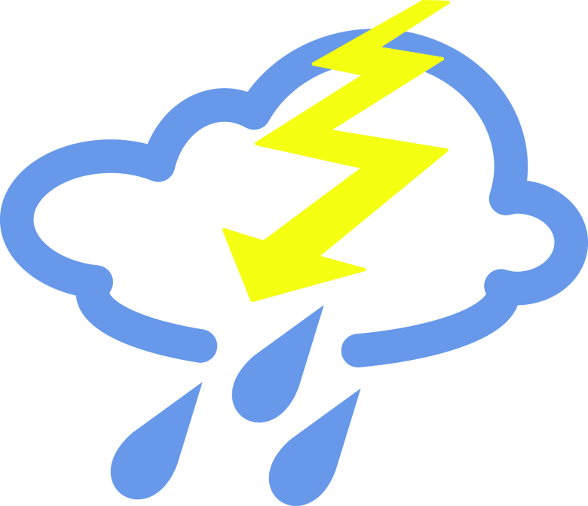
Jade Homework – Summer 2
This term our topic is called Water and the Weather
Geography Draw a diagram of the water cycle with detailed annotations of each stage. Colour in your work beautifully to show off your diagrams. | Get active Teach yourself different yoga poses. Use YouTube to watch how they are done. Ask your adult to take a photo of you once you’ve mastered the new positions. | Geography What is the difference between weather and climate? Create a poster which will help you to remember them. . | Writing Imagine you are in the middle of a severe storm and stuck in the woods with your friends. How do you stay safe? How do you get home? Write a short story and include speech from different characters as your target.
Art Look at a piece of art called The Great Wave By Hokusai. Recreate this artwork in any medium you choose. I can’t wait to see what it has inspired you to create. | Literacy/Fun Create a bank of words with their meanings that are linked to the water cycle. Using those words, can you create a fun word search for others to complete? | Maths Create a math quiz of 20 questions with multiplication and division questions. | Art/Literacy/Geography Create a comic strip showing the water cycle process. Turn your ocean, river, cloud and rain drops into characters to teach someone else the water cycle in a fun way.
ICT Use Microsoft word to type up an information fact file sheet on natural disasters linked to the weather. | Free style Google ‘How to make a tornado in a jar’ Can you make your own? | Literacy Write a recount of something you have done over the weekend. | Science Compare the weather and climate of one country in the Southern hemisphere to that of one in the Northern hemisphere. Why are they different – Can you explain?
What? You can choose as many tasks as you like, making sure you take photos or record any writing. If you need a book or
paper to write on, just ask! Some tasks are more of a challenge, if you do a good job you can earn extra diddy-dots!
When? Return for marking and a reward on Monday 14th July.

